Slide 1
J2EE Development
with free and open source tools
Aaron Mulder – Chariot Solutions – February 2004

Slide 2
Tonight, we’ll discuss…
How open source works
Understanding the licenses
Runtime products & tools
Development products & tools
General Trends
Getting involved

Slide 3
How Open
Source Works

Slide 4
Without open source…
Every company needs to develop or buy application servers, reporting tools, test frameworks, modeling tools…
If you build, new developers face a steep learning curve
If you buy, you can’t add the features you need
Either way, developers don’t have the money or access to master these tools in their spare time.

Slide 5
With open source…
Early adopters play with new technologies as they emerge
Worthy projects rise to the top
Companies add the features they need, and contribute their changes back to the project
Tools gets better and better with use
No single company has to bear the entire cost of any one tool’s development
More developers hit the ground running

Slide 6
When free != free…
Two kinds of “free” in software
Free as in beer
  Product and/or source are free of charge
  Documentation, support, training usually aren’t
Free as in speech
  You are allowed to modify and redistribute code
  Some licenses force terms on the modified code
Look at the license for details

Slide 7
Understanding the Licenses

Slide 8
Common license types
Commercial
GPL
LGPL
BSD / Apache
Academic License, MIT, etc.

Slide 9
Commercial Licenses
Custom license specific to the product
Sometimes allows free use for non-profit organizations
Sometimes allows free use for everyone
Usually prohibits reverse engineering
Usually prohibits redistribution
Rarely includes source code
May include all sorts of bizarre terms

Slide 10
GNU/General Public License (GPL)
You are free to do whatever you want with the source code (modify, redistribute, etc.)
But… any changes you make that you distribute must also be GPL
And… any code you distribute that uses GPL code must be available under GPL
Defeats “embrace and extend”
Often called “viral” by both friend and foe

Slide 11
GNU Lesser General Public License (LGPL)
Used to be called “Library GPL”
Non-LGPL code can use it without becoming LGPL (e.g. linking during compile)
Resulting combined executable is LGPL
Many people think this means that you can use LGPL Java libraries from non-LGPL code
Not clear whether that interpretation is correct
We are not your lawyers ☺

Slide 12
BSD/Apache Licenses
You can freely use, modify, re-license, etc. as long as you maintain the copyright notices
You can include the code in a commercial product without releasing your source code
You can embrace and extend
Safest for corporate use

Slide 13
Working with Licenses
Plenty of others (Academic Free License, MIT, public domain, etc.)
Read all licenses carefully
Never remove copyright or license headers – it’ll come back to haunt you
When in doubt, talk to legal folks

Slide 14
Runtime
Products & Tools

Slide 15
Operating Systems
Take a look at…
Linux
FreeBSD
Windows, MacOS, Solaris when it’s bundled with your machine

Slide 16
Operating Systems
Conclusions…
Often free with the hardware
Use what you’re most productive with
Different platforms in the same development team help portability, but can make it harder to help each other
Someone should use the target OS

Slide 17
Databases
Take a look at…
PostgreSQL
MySQL
SAP DB
HyperSonic / HSQL
McKoi
Xindice

Slide 18
Databases
Conclusions…
Several worth free offerings that are easy to administrate
Often the best choice for applications that need embedded databases
Be sure to still test early and often with the production database

Slide 19
Persistence Frameworks
Take a look at…
EJB CMP
OJB
Hibernate
Castor
Torque
JORM

Slide 20
Persistence Frameworks
Conclusions…
Don’t write SQL
(unless you have to…)

Slide 21
XML Binding
Take a look at…
XMLBeans
JiBX
Castor
JAXB Reference Implementation
JaxMe

Slide 22
XML Binding
Conclusions…
Many great tools
Don’t use SAX and DOM unless you need to
Useful for handy persistence during development.

Slide 23





Application Servers
Take a look at…
Tomcat (Servlets only)
Jetty (Servlets only)
JBoss (full J2EE bundles)
Apache Geronimo (full J2EE bundles)
JOnAS (full J2EE bundles)
OpenEJB, OpenJMS, JORAM, JOTM

Slide 24
Application Servers
Conclusions…
Right now, look to JBoss/Tomcat or JBoss/Jetty for production
Don’t expect fancy graphical tools or documentation
Look to Apache Geronimo next year
Lots of companies providing support

Slide 25
Web Frameworks
Take a look at…
Struts
Cocoon
Turbine
Velocity
Tapestry
WebWork
Spring (complete IOC framework)

Slide 26
Web Frameworks
Conclusions…
Struts is the most popular, with huge developer and corporate followings
Worth looking at Cocoon, still some potential performance issues
Others are loved by many, but less well-known in general, harder to find developers

Slide 27
Portals, Integration, Workflow, etc.
Take a look at…
Jetspeed
Cocoon Portal
Open For Business (OFBiz), Compiere
InfoSapient
JPos, Mercator

Slide 28
Portals, Integration & Workflow
Conclusions…
Still weak and unpolished compared to commercial offerings
Starting to get more attention
Portlet API (JSR 168) will really make a difference
Good headstart if you’ve chosen to build instead of buy

Slide 29
Content Management
Take a look at…
Cofax
OpenCMS

Slide 30
Content Management
Conclusions…
We’re still evaluating these…
Good enough for many large publishing houses
Not as well-tested in other industries

Slide 31
Reporting
Take a look at…
JasperReports
DataVision
JFreeReports
JCharts
iText
FOP
POI

Slide 32
Reporting
Conclusions…
Great for small numbers of canned reports
Get a commercial product if you have dedicated report writers
Get a commercial product if users need to create complex ad-hoc reports

Slide 33
Scheduling
Take a look at…
Cron
JCronTab
Quartz

Slide 34
Scheduling
Conclusions…
Platform-independent scheduling
Can be embedded in J2EE applications
JCronTab is a simple cron-like scheduler
Quartz is more powerful but more complicated

Slide 35
Development Products & Tools

Slide 36


IDEs
Take a look at…
Eclipse
NetBeans

Slide 37
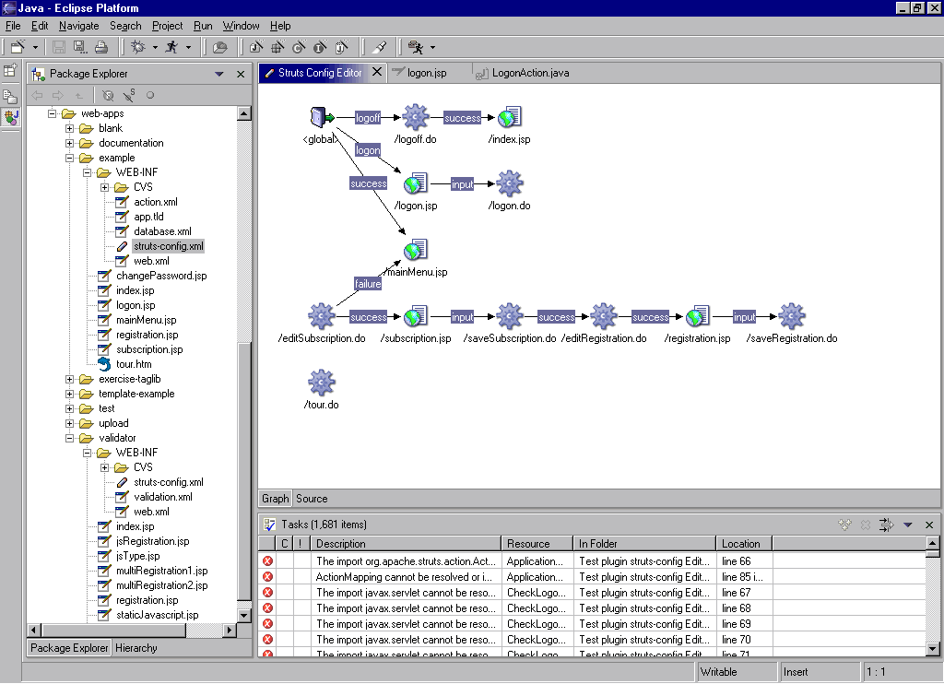
IDEs – Eclipse Screenshot

Slide 38
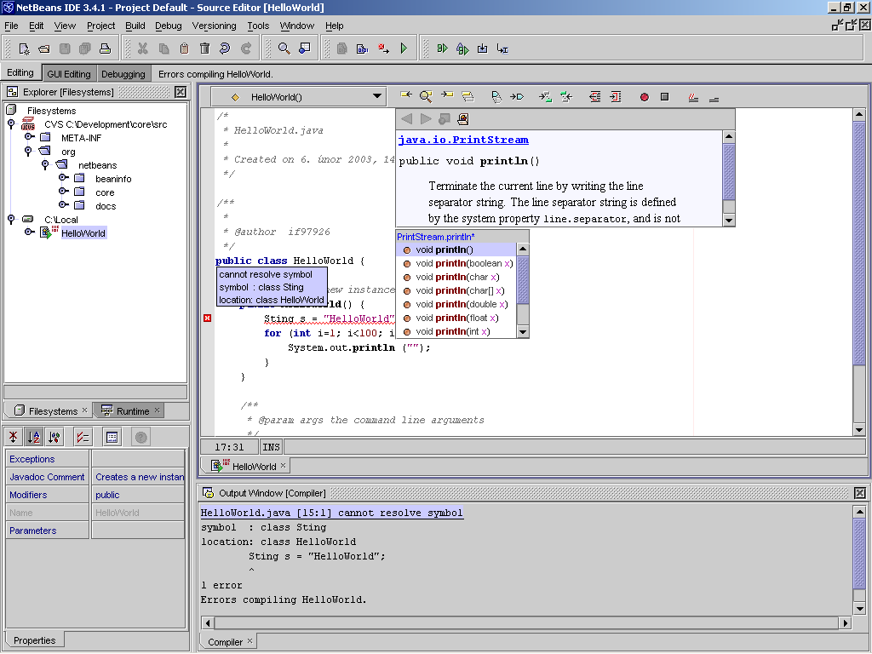
IDEs – NetBeans Screenshot

Slide 39
IDEs
Conclusions…
Everything you need to develop
Lots of great plug-ins
IBM and Borland tools have more advanced modeling/GUI design features
We still love and use IntelliJ ☺

Slide 40
Database Browsers
Take a look at…
SQuirreL
TORA
DBVisualizer
TOAD

Slide 41
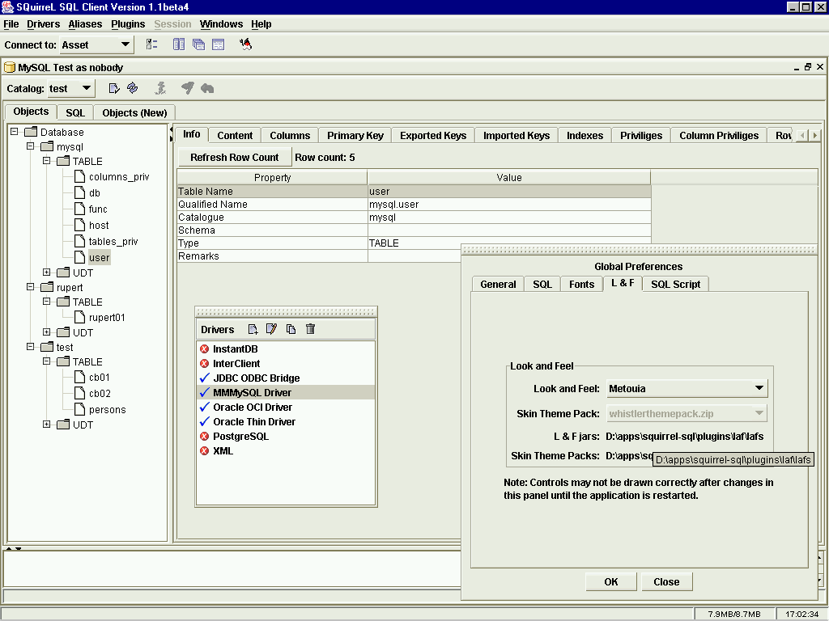
DB Browsers – SQuirreL

Slide 42
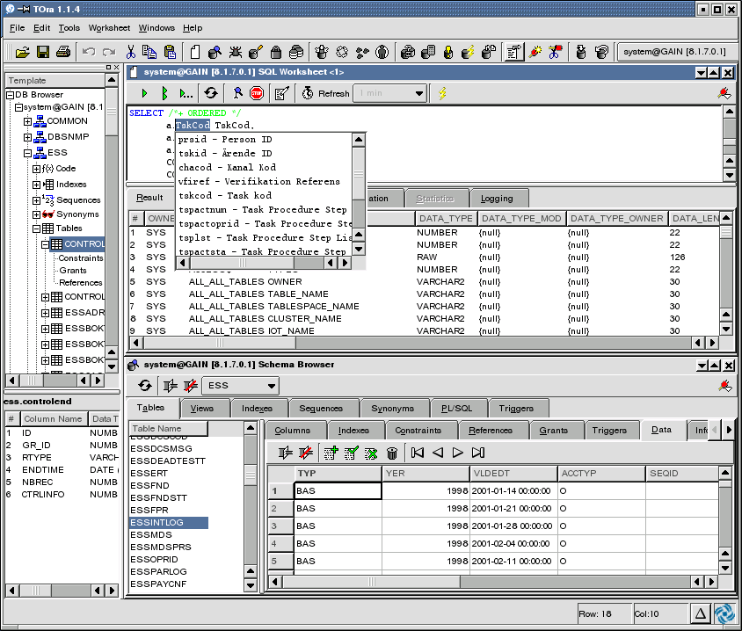
DB Browsers – TORA

Slide 43
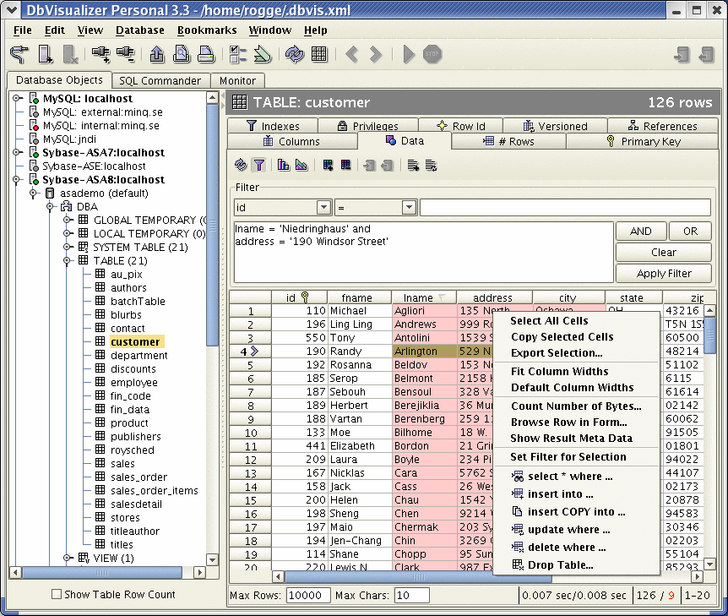
DB Browsers – DBVisualizer

Slide 44
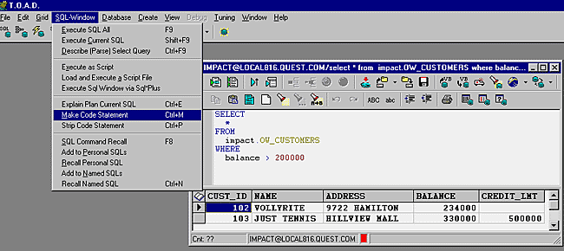
DB Browsers – TOAD

Slide 45
Database Browsers
Conclusions…
If you work with databases, you should definitely be using a database browser
Free offerings usually fit the bill
Most are limited to the JDBC API
Look to commercial products for administrative and database-specific functionality

Slide 46


Source Control
Take a look at…
CVS
Subversion
CVSWeb, ViewCVS, QueryCVS, etc.

Slide 47
Source Control
Conclusions…
CVS has been the clear winner
Great concurrent, non-locking access
Great tools integration, GUI support
Easily integrated with other systems (bug-tracking, email, etc.)
Great for secure, remote development
But… perhaps time to try Subversion?

Slide 48
Documentation
Take a look at…
DocBook
OpenOffice
Structured Text
HTML

Slide 49
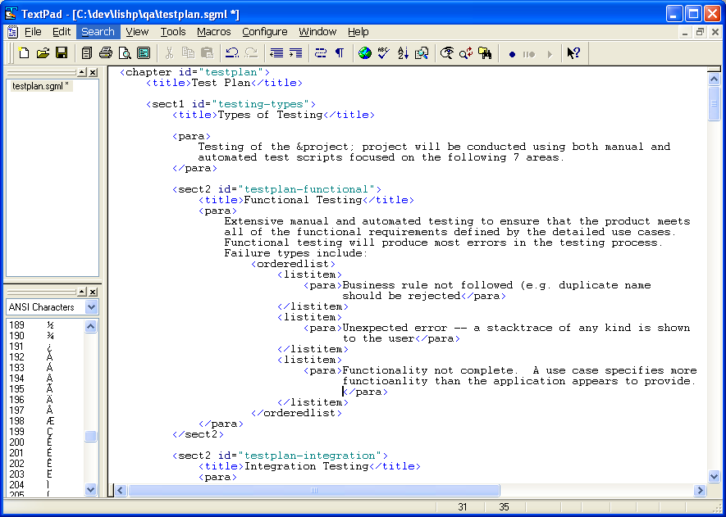
Documentation – DocBook Source

Slide 50
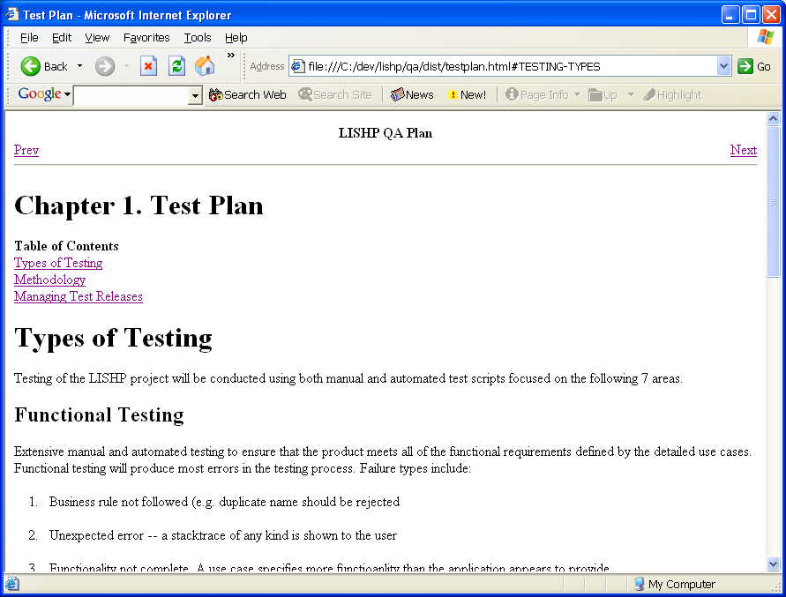
Documentation – DocBook HTML

Slide 51
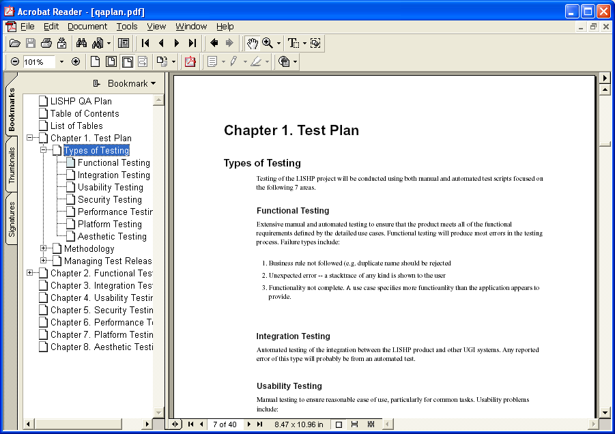
Documentation – DocBook PDF

Slide 52
Documentation
Conclusions…
Text-based format great for version control
Developers can edit docs from within IDE
Can configure CVS to rebuild browsable documentation on every check-in
DocBook produces great, professional looking PDFs (with WYSIWIG support in OpenOffice and XXE)
Go with XML version, not SGML

Slide 53
Collaboration
Take a look at…
MoinMoin wiki
UseMod wiki
Jabber
Mailman

Slide 54
Collaboration
Conclusions…
Wikis are great for impromptu documentation
Developers will share invaluable tips & tricks
Perfect for style guidelines, product reviews, etc.
Jabber allows private IM network
Mailman great for internal mailing lists

Slide 55



Modeling/Design
Take a look at…
Eclipse Modeling Framework (EMF) with free edition of Omondo’s EclipseUML Plug-In
ArgoUML, Poseidon Community Edition

Slide 56
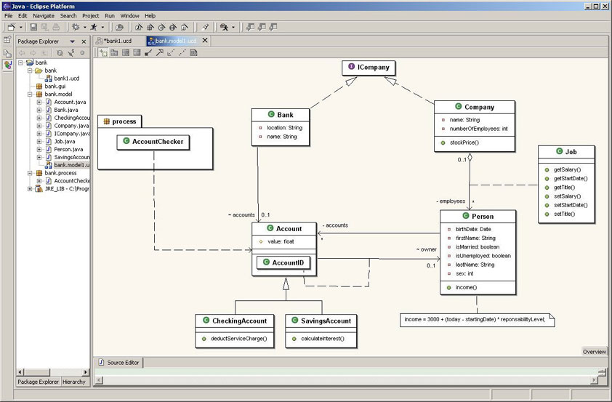
Modeling – EclipseUML

Slide 57
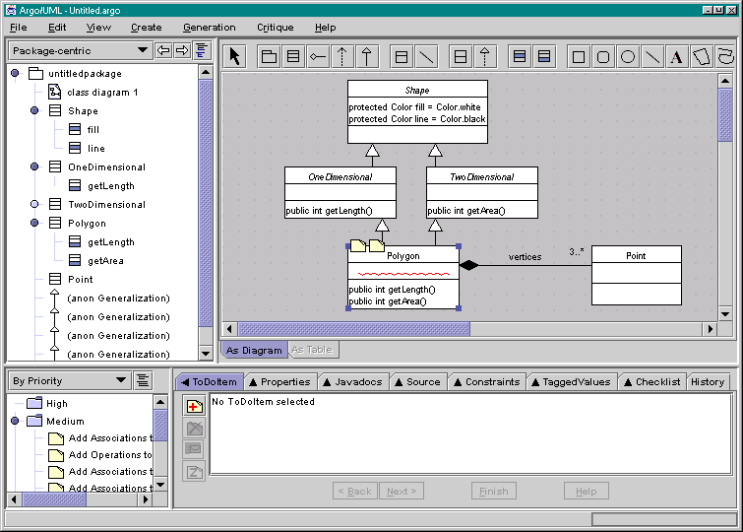
Modeling – ArgoUML Screenshot

Slide 58
Modeling/Design
Conclusions…
Not quite there yet
Eclipse’s EMF projects are starting to offer sophisticated modeling and code generation
Not as simple to configure and use as many commercial modelers

Slide 59
Code Generation
Take a look at…
XDoclet
MiddleGen
Jostraca
Karapan Sapi, ModelJ, JADE, etc.

Slide 60
Code Generation
Conclusions…
Don’t maintain deployment descriptors by hand
Code generation can be great for both rapid application development and pattern reuse
Integrate with modeling tools for push-button application generation

Slide 61
Profiling
Take a look at…
Sun JVM options (-Xprof, -Xrunhprof)
Eclipse profiler plug-ins

Slide 62
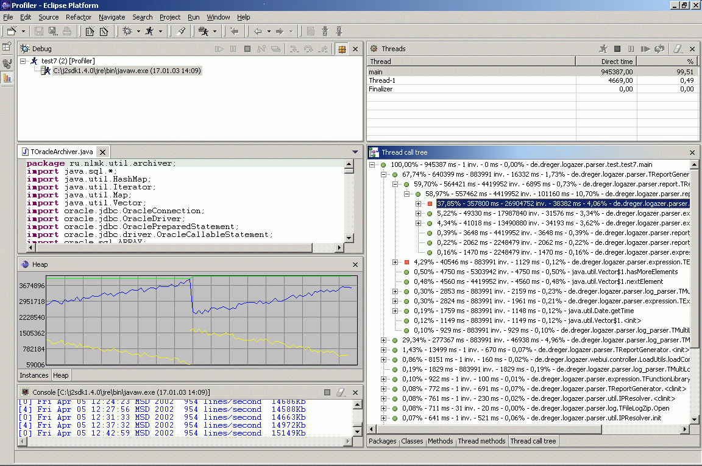
Profiling – Eclipse Profiler Plug-In

Slide 63
Profiling
Conclusions…
Can’t beat OptimizeIt, but…
Every project can benefit from the built-in JVM tools
Eclipse Profiler plug-in looks a lot like popular commercial profilers
Use with a load-generator to investigate performance under realistic conditions

Slide 64

Testing
Take a look at…
JUnit family (HttpUnit, JUnitPerf, etc.)
Cactus
JMeter
Grinder, http_load, etc.
http://www.javaperformancetuning.com

Slide 65
Testing
Conclusions…
JUnit works great for unit testing
Plenty of options for load generation
Lots of proxies for point-and-click automated testing of web applications
Still weak on automated testing of Swing apps
Poor integration with specs, bugtracking, etc.

Slide 66
Bug Tracking
Take a look at…
Bugzilla and variants
Scarab
JIRA (if non-profit)
ITracker

Slide 67
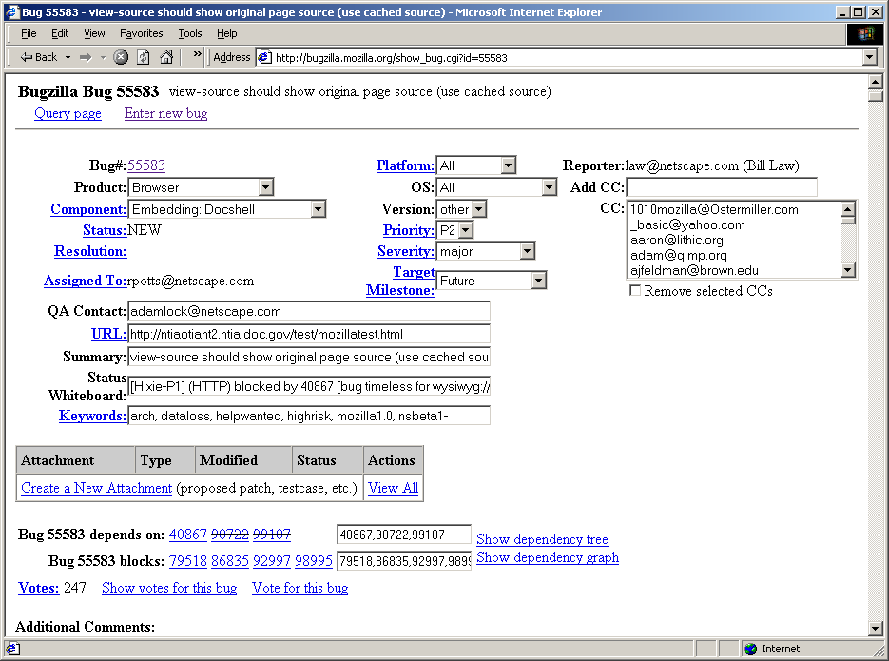
Bug Tracking – Bugzilla

Slide 68
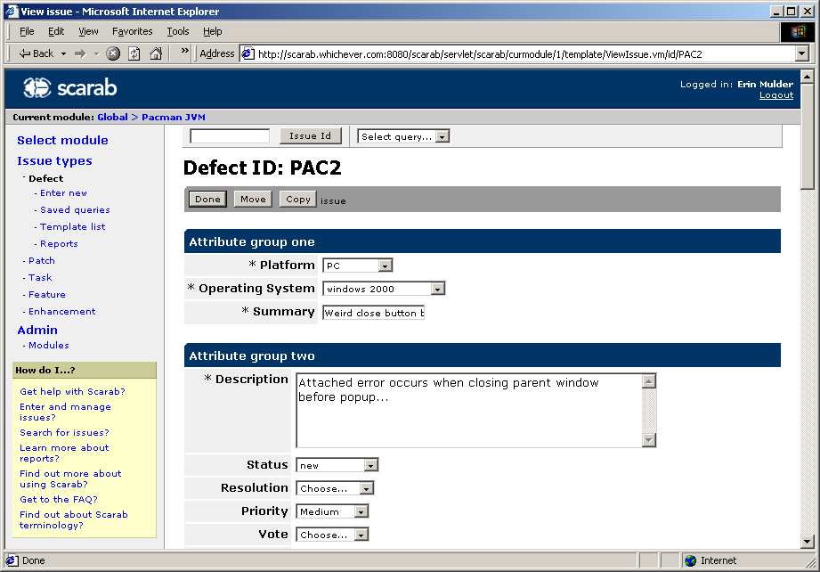
Bug Tracking – Scarab

Slide 69
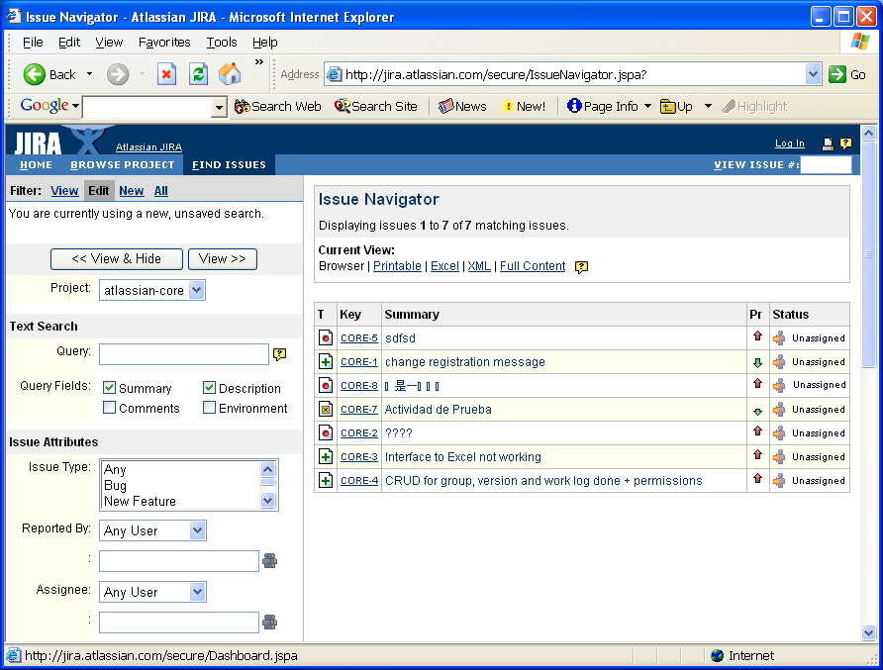
Bug Tracking – JIRA

Slide 70
Bug Tracking
Conclusions…
JIRA is great, but only free for noncommercial use
Other free offerings get the job done
Still some usability issues
Don’t integrate as well with requirements tracking, testing and general project management products

Slide 71
Scripting & Debugging
Take a look at…
Jython
AspectJ
Castor

Slide 72
Scripting & Debugging
Conclusions…
Open source tools can solve a lot of problems you didn’t even know you had
Consider useful ways you can use them during development, even if you disable them for delivery
Experiment with scripting languages and other methods to minimize the debug>>fix>>rebuild>>test cycle

Slide 73


Build Management
Take a look at…
Ant
Maven
AntHill
CruiseControl

Slide 74
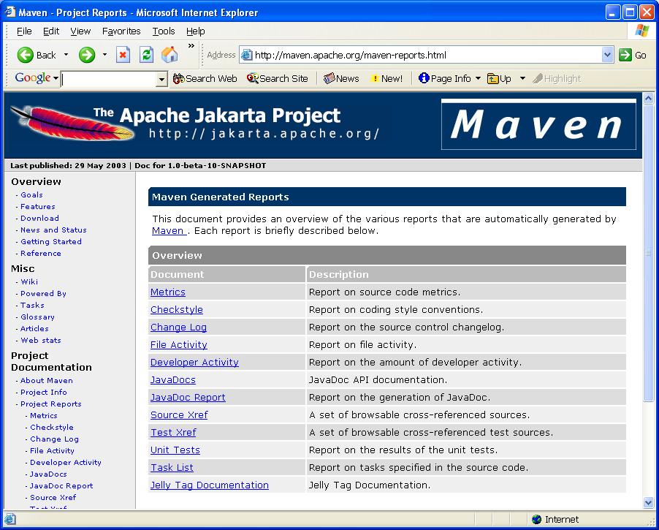
Build Management – Maven

Slide 75
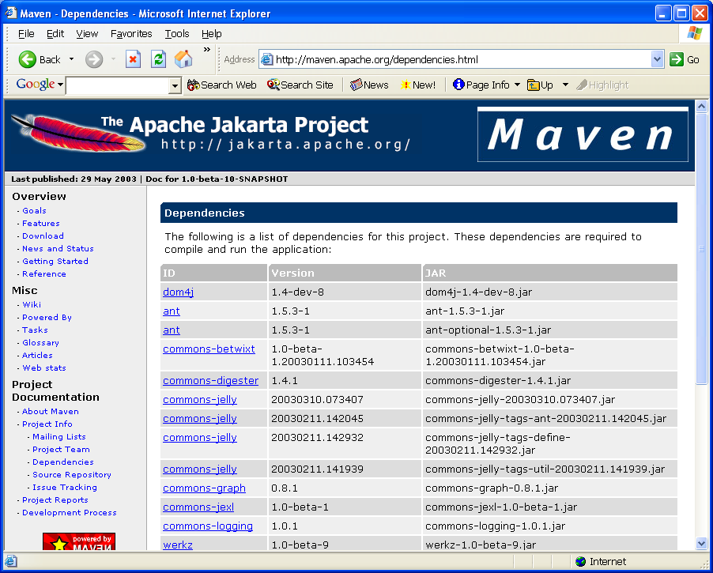
Build Management – Maven

Slide 76
Build Management
Conclusions…
Ant is the de facto standard
Maven helps coordinate builds across projects
AntHill and CruiseControl offer automation

Slide 77
Project Management
Take a look at…
XPlanner
Tutos

Slide 78
Project Management
Conclusions…
Lots of MS-Project knock-offs out there
Free tools don’t integrate full lifecycle management (reqs, tasks, tests, bugs, releases, etc.) the way some commercial suites do
If you’re interested in helping to change that, email jellico@opentools.org

Slide 79
General Trends

Slide 80
General Trends
Very strong on basic infrastructure
Recent IDE releases integrate tons of development tools
Still weak on full project lifecycle integration (spec, dev, test, bugs, etc.)
Still weak on value-added enterprise features (portals, connectors, caching, graphical interfaces)
Where are the open-source UI experts?

Slide 81
Getting Involved

Slide 82
Finding open source
Freshmeat, Sourceforge (overwhelming)
Slashdot.org
TheServerSide.com
Apache
GNU
JBoss
Eclipse

Slide 83
Contributing
Start using open source software
Get on the mailing lists for your favorite project
Develop patches that fix bugs or add features you need
Contribute those patches
When developers get tired of applying all the patches you generate, they’ll give you commit access ☺

Slide 84
More Information
Email:
emulder@chariotsolutions.com
ammulder@chariotsolutions.com
Slides will be posted at:
www.chariotsolutions.com

Slide 85
Linux
http://www.linux.org/
FreeBSD
http://www.freebsd.org/
PostgreSQL
http://www.postgresql.org/
MySQL
http://www.mysql.org/
SAP DB
http://www.sapdb.org/
Hypersonic/Hsql
http://hsqldb.sourceforge.net/
McKoi
http://mckoi.com/database/
Xindice
http://xml.apache.org/xindice/
OJB
http://db.apache.org/ojb/
Hibernate
http://www.hibernate.org/
Castor
http://castor.exolab.org/
Torque
http://db.apache.org/torque/
JORM
http://jorm.objectweb.org/
XMLBeans
http://xml.apache.org/xmlbeans/
JiBX
http://jibx.sourceforge.net/
Castor
http://castor.exolab.org/

Slide 86
JAXB Reference Implementation
http://java.sun.com/xml/jaxb/
JaxMe
http://ws.apache.org/jaxme/
Tomcat
http://jakarta.apache.org/tomcat/
Jetty
http://jetty.mortbay.org/jetty/
JBoss
http://www.jboss.org/
Apache Geronimo
http://incubator.apache.org/
projects/geronimo.html
JOnAS
http://jonas.objectweb.org/
OpenEJB
http://openejb.sourceforge.net/
OpenJMS
http://openjms.sourceforge.net/
JORAM
http://joram.objectweb.org/
JOTM
http://jotm.objectweb.org/
Struts
http://jakarta.apache.org/struts/
Cocoon
http://cocoon.apache.org/
Turbine
http://jakarta.apache.org/turbine/
Velocity
http://jakarta.apache.org/velocity/
Tapestry
http://jakarta.apache.org/tapestry/

Slide 87
WebWork
http://opensymphony.com/webwork/
Jetspeed
http://jakarta.apache.org/jetspeed/
Cocoon Portal
http://cocoon.apache.org/
Open For Business (OFBiz)
http://www.ofbiz.org/
Compiere
http://www.compiere.org/
InfoSapient
http://info-sapient.sourceforge.net/
JPOS
http://www.jpos.org/
Mercator
http://www.globalretailtech.com/
Cofax
http://www.cofax.org/
OpenCMS
http://www.opencms.org/opencms/
JasperReports
http://jasperreports.sourceforge.net/
DataVision
http://datavision.sourceforge.net/
JFreeReport
http://www.jfree.org/
JCharts
http://jcharts.sourceforge.net/
iText
http://www.lowagie.com/iText/
Apache FOP
http://xml.apache.org/fop/

Slide 88
POI
http://jakarta.apache.org/poi/
Cron
http://www.linux.org/
JCronTab
http://jcrontab.sourceforge.net/
Quartz
http://www.quartzscheduler.org/
Eclipse
http://www.eclipse.org/
NetBeans
http://www.netbeans.org/
SQuirreL
http://squirrel-sql.sourceforge.net/
TORA
http://www.globecom.se/tora/
DBVisualizer
http://www.minq.se/products/dbvis/
TOAD
http://www.toadsoft.com/
CVS
http://www.cvshome.org/
Subversion
http://subversion.tigris.org/
CVSWeb
http://www.freebsd.org/projects/
cvsweb.html
ViewCVS
http://viewcvs.sourceforge.net/
DocBook
http://www.docbook.org/

Slide 89
OpenOffice
http://www.openoffice.org/
Structured Text
http://www.zope.org/
Documentation/Articles/STX
MoinMoin Wiki
http://moin.sourceforge.net/
UseMod Wiki
http://www.usemod.com/
cgi-bin/wiki.pl?UseModWiki
Jabber
http://www.jabber.org/
Mailman
http://www.gnu.org/software/mailman/
Eclipse Modeling Framework
http://www.eclipse.org/emf/
ArgoUML
http://argouml.tigris.org/
Poseidon Community Edition
http://www.gentleware.com/
XDoclet
http://xdoclet.sourceforge.net/
MiddleGen
http://boss.bekk.no/boss/middlegen/
Jostraca
http://www.jostraca.org/
JUnit
http://www.junit.org/
Cactus
http://jakarta.apache.org/cactus/
JMeter
http://jakarta.apache.org/jmeter/
Grinder
http://grinder.sourceforge.net/

Slide 90
Bugzilla
http://bugzilla.mozilla.org/
Scarab
http://scarab.tigris.org/
JIRA
http://www.atlassian.com/software/jira/
ITracker
http://www.cowsultants.com/
BeanShell
http://www.beanshell.org/
Jython
http://www.jython.org/
JRuby
http://jruby.sourceforge.net/
Groovy
http://groovy.codehaus.org/
AspectJ
http://eclipse.org/aspectj/
Ant
http://ant.apache.org/
Maven
http://maven.apache.org/
AntHill
http://www.urbancode.com/projects/
anthill/
CruiseControl
http://cruisecontrol.sourceforge.net/
XPlanner
http://www.xplanner.org/
Tutos
http://www.tutos.org/

